Slide 1
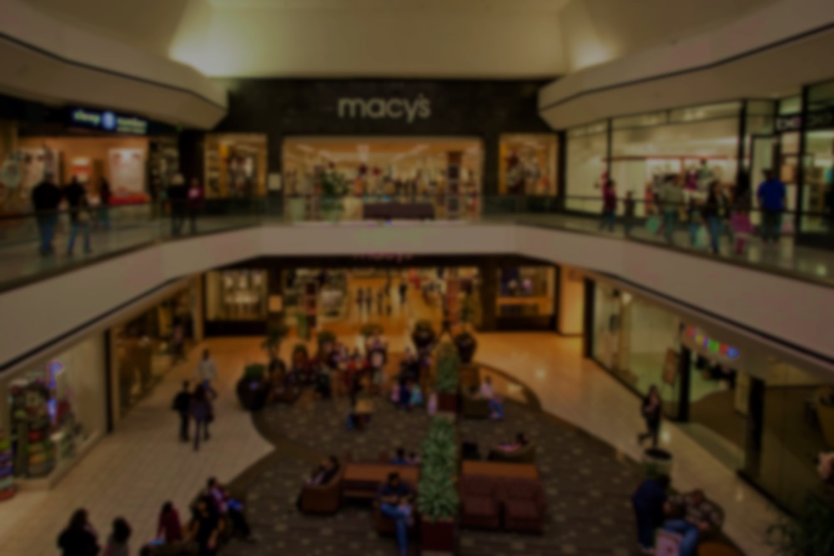
Three Slides
window
Mixed Reality
Max Freundlich, Kristen Law, Elisa Lupin-Jimenez

Slide 2

Value Proposition
Three Tasks
Video Storyboards

Slide 3
Value Proposition
Three Tasks
Video Storyboards

Slide 4

Value Proposition: “Window shopping made easier”
We are addressing the complaints of many shoppers that the process of picking clothes to purchase is frustrating and time-consuming. We hope to solve this problem by making an augmented reality assisted phone application that shoppers can use to see what a specific store has in stock (via an AR model that appears in the store’s window) without ever having to step inside the store.

Slide 5
Value Proposition
Three Tasks
Video Storyboards

Slide 6
Value Proposition
Three Tasks
Video Storyboards

Slide 7
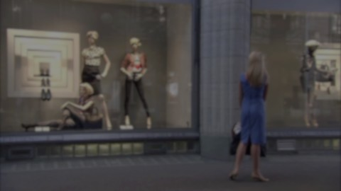
Three Tasks
Simple:
A shopper wants to purchase an outfit for themselves for a casual outing, such as a night with friends, a party, or a simple gathering.
Medium:
A shopper, who is currently with a group, is looking for high-end or professional attire for a business event or a formal affair.
Complex:
A shopper is trying to find the perfect clothes to get for someone other than themselves.

Slide 8
Value Proposition
Three Tasks
Video Storyboards

Slide 9
Value Proposition
Three Tasks
Video Storyboards

Slide 10
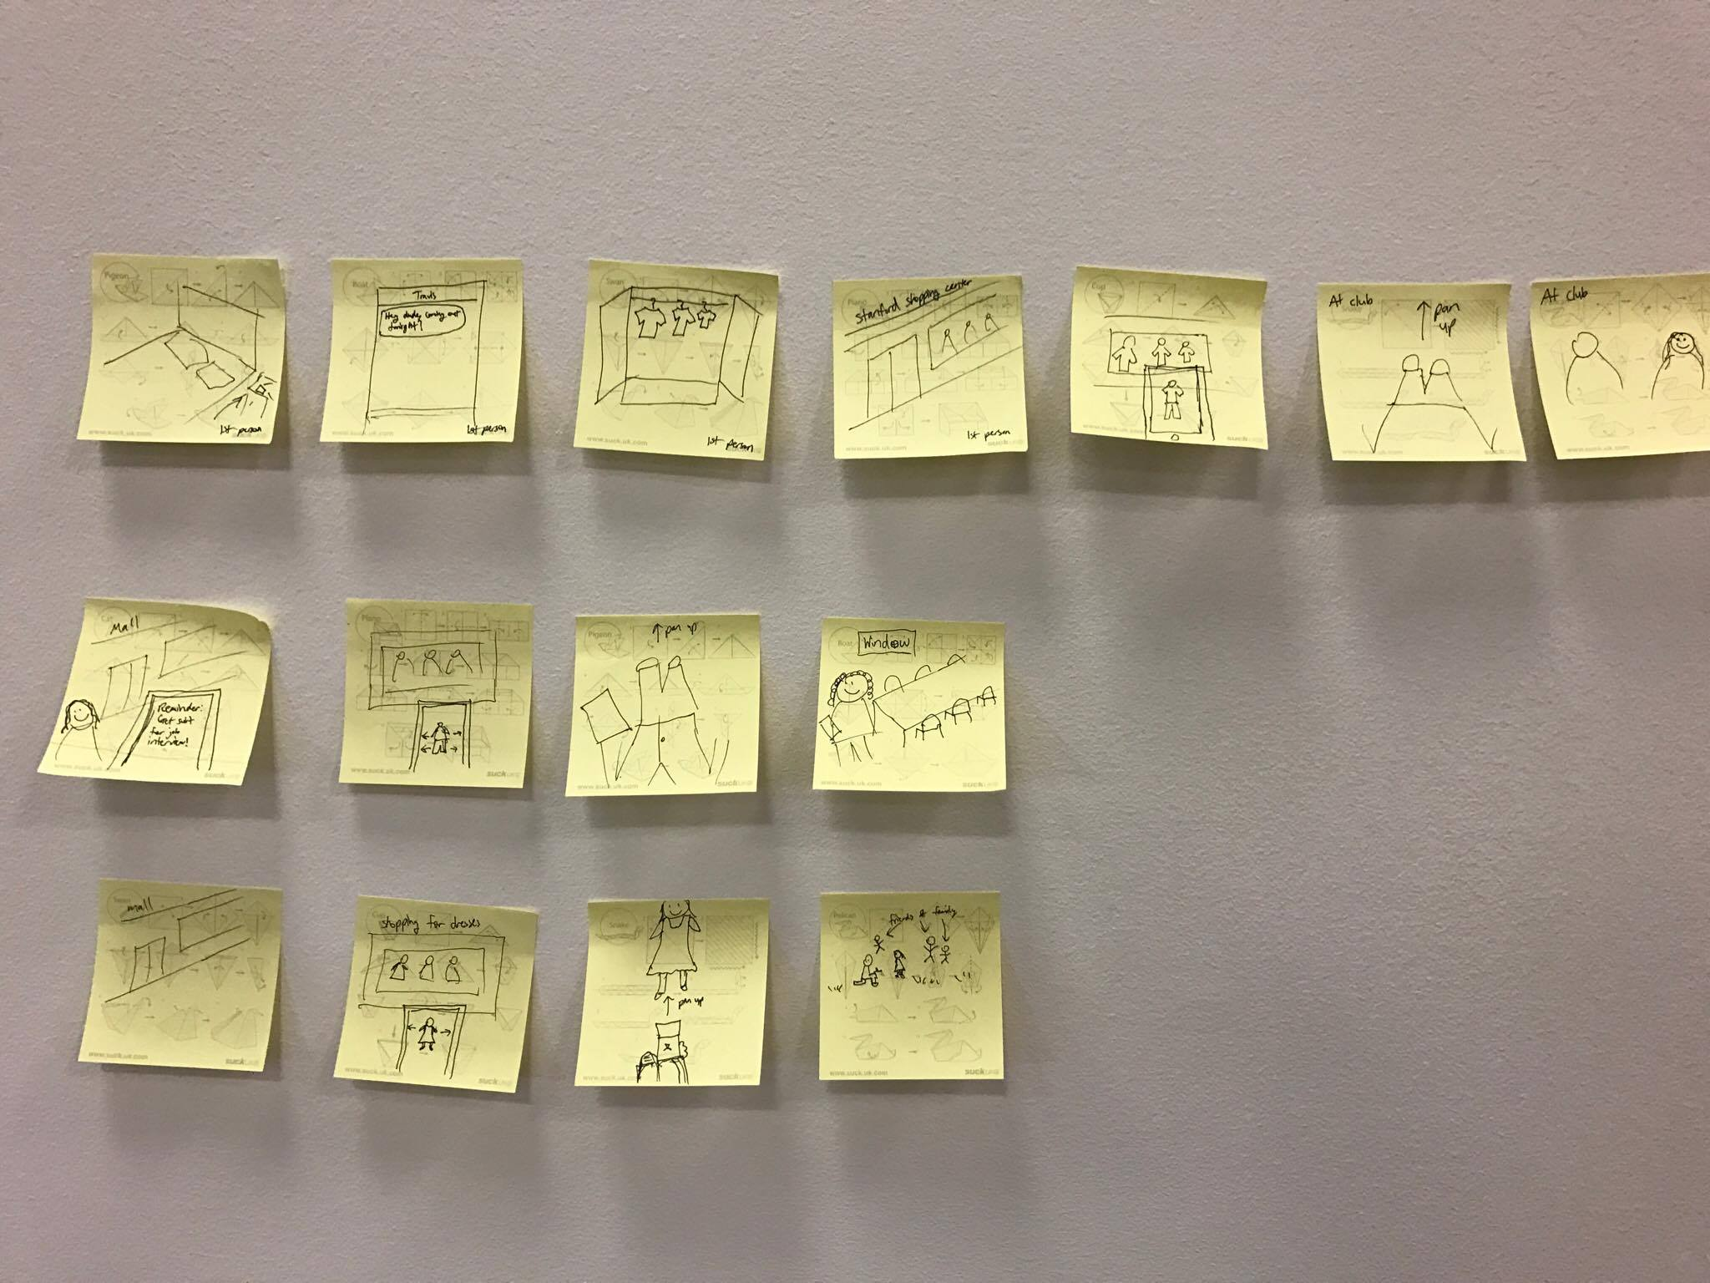
Video Storyboards
Simple
Medium
Complex

Slide 11

Questions?

